Slide 1

Amanda - Mini Project 3
26 Sep 2026
Segmenting Singapore Neighbourhoods for Targeted Senior Digital Inclusion
A data-driven approach to neighbourhood-specific outreach
Notes:
My project looks at whether Singapore neighbourhoods can be grouped based on their senior demographics and access to public infrastructure, and how these profiles could support more targeted senior digital-inclusion outreach.

Slide 2
Problem statement
Reflects Neigh-
bourhood
What distinct neighbourhood profiles exist, and how can they inform more targeted senior digital-inclusion outreach?
Fails to Account
Differences
for Differences
Informs
May Not Reflect
Targeted
Differences
Outreach
Neighbourhoods differ in senior
population, Wireless@SG access,
Community Club access, and
Library access.
Uniform Outreach
Targeted Outreach
Notes:
A common starting point for senior outreach might be to focus on neighbourhoods with large senior populations. But senior population alone doesn't tell us the full story. Two neighbourhoods may have similarly large senior populations but very different access to Community Clubs, Wireless@SG hotspots or libraries. So rather than treating all high-senior neighbourhoods the same, my project looks at both demographics and infrastructure accessibility to identify different neighbourhood profiles.
This leads to the problem statement: what distinct neighbourhood profiles exist, and how can these profiles inform more targeted senior digital-inclusion outreach?

Slide 3
Stakeholders & Value Proposition
Use neighbourhood segmentation to support more targeted decisions on where and how senior digital-inclusion outreach could be delivered
Stakeholders
Data Collection
Stakeholders include government
Segmentation
agencies and community
organisations supporting seniors
who may require digital support.
Strategy Development
Limited outreach resources need to
be deployed effectively.
Targeted Outreach
Notes:
The key stakeholders are government agencies and community organisations involved in senior digital inclusion. Because outreach resources are limited, the objective isn't simply to identify where seniors live, but to provide a framework that can help differentiate where and how support could be delivered.
To build that neighbourhood-level view, I combined five datasets

Slide 4
Building a neighbourhood-level view
Analysis integrates 5 primary datasets to build a comprehensive view of 232 subzones
Public Libraries
Essential infrastructure for
Community Clubs
digital access and learning
Key physical touchpoints for
community engagement
Wireless@SG Hotspots
Public WiFi availability and
URA Subzone
proximity
Boundaries
Census 2020 Population
Geographic framework for
neighbourhood analysis
Granular demographic data on
seniors aged 65+
Source: data.gov.sg — SingStat, URA, IMDA, People's Association, National Library Board
Notes:
To build a neighbourhood-level view, I combined five datasets. Census 2020 provided the senior population data, while URA subzone boundaries provided the geographic unit of analysis. I then incorporated Wireless@SG hotspots, Community Clubs and public libraries as forms of public infrastructure that could potentially support digital-inclusion outreach.
After cleaning and matching the datasets, 232 subzones were included in the analysis

Slide 5
Data cleaning & Feature engineering
8 features x 232 subzones
Infrastructure Proximity
Distance to nearest Wireless@SG hotspot
Distance to nearest Community Club
Distance to nearest library
1
Infrastructure Availability
Wireless@SG hotspot count
Community Club count
Library count
2
Demographic
Senior population aged 65+
Senior percentage
3
Notes:
From these datasets, I engineered eight features across three dimensions. The first captures senior demographics. The second captures infrastructure availability through facility counts within each subzone. The third captures proximity by measuring the distance from each subzone centroid to the nearest facility.
These features measure physical infrastructure accessibility; they do not directly measure digital inclusion.

Slide 6
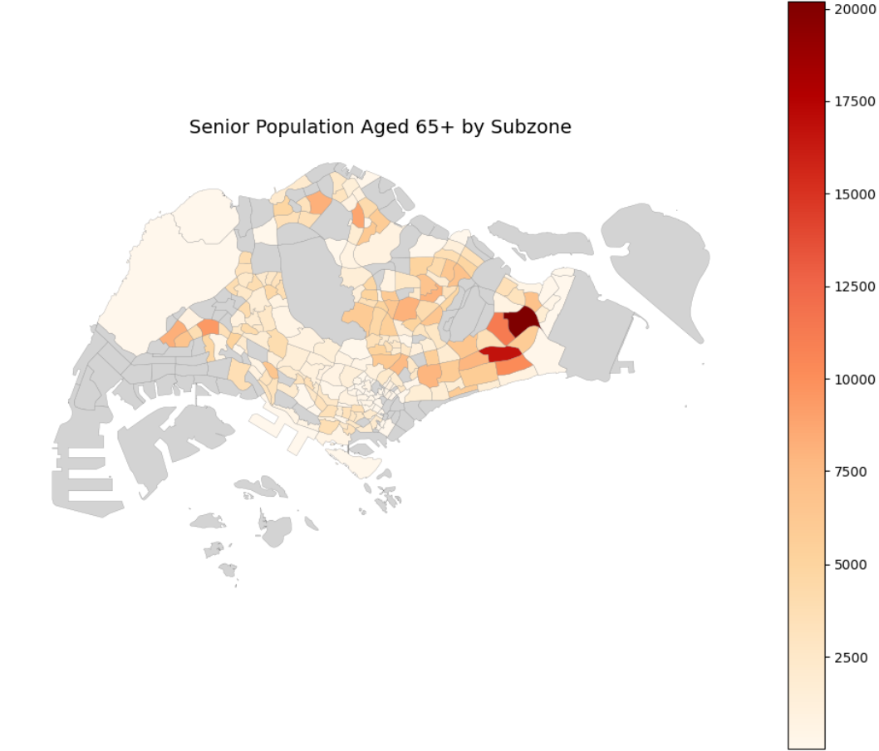
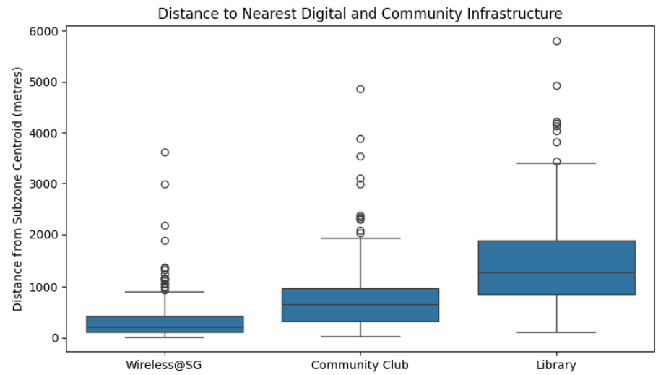
EDA 1: Neighbourhoods differ in both senior population & infrastructure accessibility
Senior Population
Senior populations vary substantially across subzones
Most subzones have smaller senior populations, while a few have much larger senior populations
Infrastructure Accessibility
Infrastructure availability and proximity also vary across subzones
Wireless@SG is generally more accessible, while libraries are fewer and typically further away
Neighbourhood needs cannot be understood from senior population alone, infrastructure context matters too.
High senior population does not equal poor infrastructure access.
Notes:
The exploratory analysis first showed substantial variation across subzones. Senior populations are highly uneven, with many subzones having relatively smaller senior populations and a smaller number having very large senior populations. Infrastructure accessibility also varies — Wireless@SG tends to be more accessible, while libraries are much fewer and generally further away.
So neighbourhoods differ on both sides of the problem: demographics and infrastructure.
I then looked at whether these two dimensions were related

Slide 7
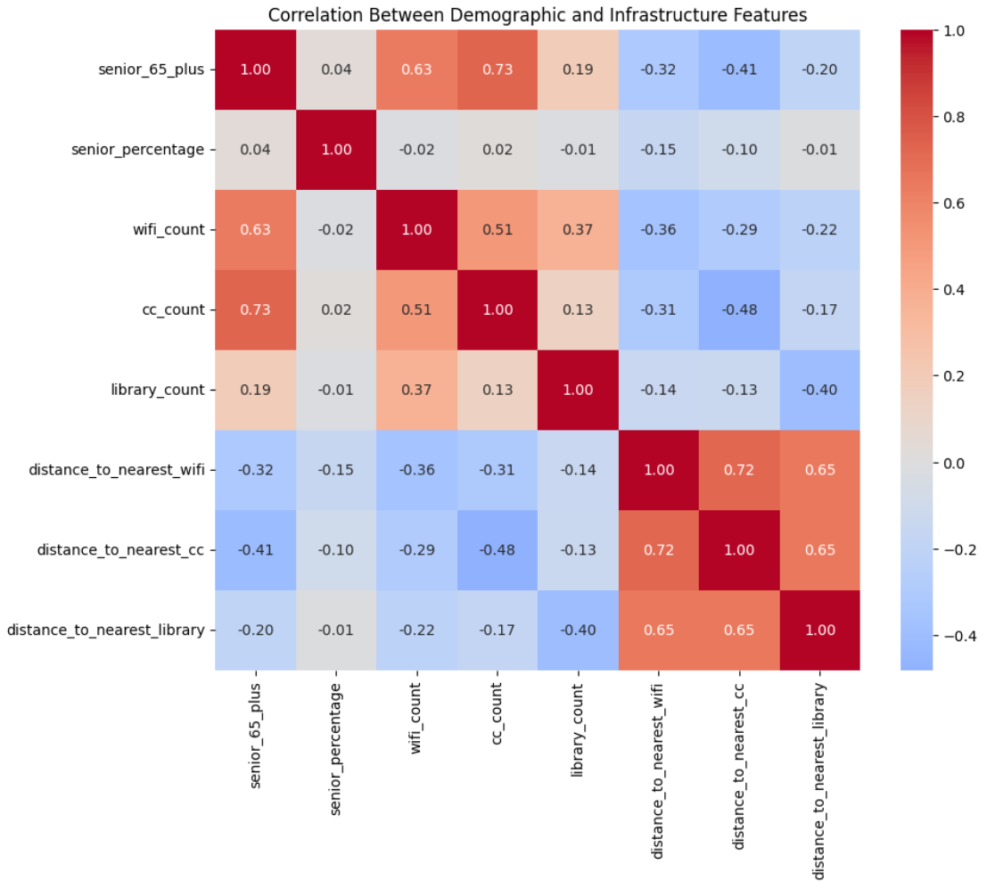
EDA 2: Subzones with larger senior populations tend to have more WiFi hotspots and Community Clubs
+0.63
Senior population ↔ WiFi
High senior populations are strongly correlated with better
infrastructure access.
+0.73
Senior population ↔ Community
High senior population does not equal poor infrastructure access.
Notes:
Interestingly, larger senior populations were associated with more Wireless@SG hotspots and Community Clubs, with correlations of 0.63 and 0.73. So the areas with the most seniors aren't necessarily the areas with the least infrastructure.
This suggests that looking at senior population or infrastructure in isolation may miss different neighbourhood contexts. I therefore analysed all eight characteristics together.

Slide 8
Modelling: Scale, PCA, 4 Clusters
Why Standard Scaler?
Both PCA and K-Means are sensitive to scale
Without Standardisation, variables with larger numerical values would have greater influence simply due to large numbers
Why Principal Component Analysis (PCA)?
Reduce redundancy among correlated infrastructure features
8 to 4 principal components
~85% variance retained
Why 4 Clusters?
Elbow method + silhouette analysis + interpretability
k = 4 | Silhouette score: 0.358
8 features
Standard Scaler
PCA
K-Means
4 Neighbourhood Profiles
Note: k=6 achieved the highest silhouette (~0.368); k=4 (~0.358) was selected for comparable separation, elbow support and greater interpretability.
Notes:
K-Means unsupervised learning was selected to identify naturally occurring neighbourhood profiles, as there was no target variable to predict.
Before clustering, I standardised the variables because they're measured in very different units — population counts, percentages, facility counts and metres. Both PCA and K-Means are sensitive to scale.
I then used PCA because several infrastructure variables were correlated, particularly the distance measures. This reduced eight variables to four principal components while retaining about 85% of the original variance.
I tested different values of k using the elbow and silhouette methods. Although six clusters produced the highest silhouette score at about 0.368, four clusters produced a very similar score of 0.358 and gave a simpler, more interpretable segmentation. I therefore selected four.

Slide 9
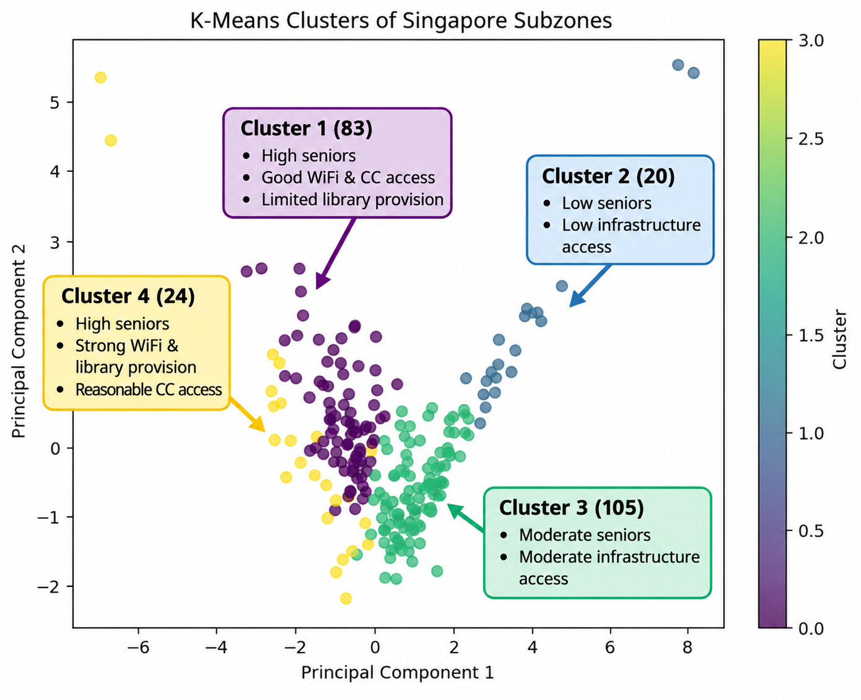
Result: Four Neighbourhood Profiles Emerged
Similar senior populations can have different infrastructure profiles
Clusters 0 and 3 have similarly high senior populations (~4,513 vs ~4,397) but differ in the type and level of infrastructure provision
Cluster 4 (24)
Cluster 1 (83)
High seniors
Strong WiFi & library provision
Reasonable CC access
High seniors
Good WiFi & CC access
Limited library provision
232 subzones
Cluster 3 (105)
Cluster 2 (20)
Moderate seniors
Moderate infrastructure access
Low seniors
Low infrastructure access
Notes:
Four distinct neighbourhood profiles emerged. The most interesting comparison is between Clusters 0 and 3. Both contain relatively high senior populations, averaging approximately 4,500 and 4,400 seniors per subzone respectively.
But their infrastructure environments differ. Cluster 1 has good WiFi and Community Club access but limited library provision, while Cluster 4 has particularly strong WiFi and library provision, together with reasonable CC access.
So similar senior populations do not necessarily mean similar infrastructure environments.
The PCA plot shows that the four clusters have distinguishable patterns, although there is some overlap between groups. This is expected because neighbourhood characteristics exist on a continuum rather than forming perfectly distinct groups.

Slide 10
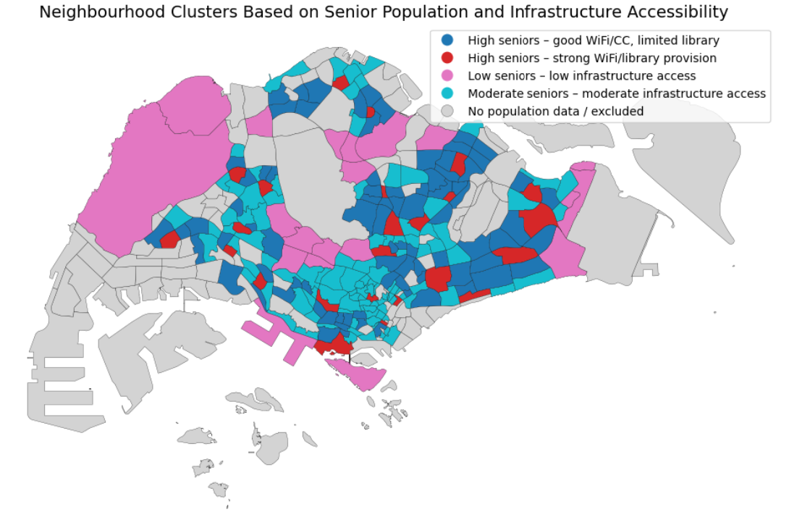
Recommendation: From Neighbourhood profiles to Differentiated Outreach
Profiles are distributed across Singapore, highlighting the importance of neighbourhood-level targeting
Cluster | Strategy | Recommendation
1 | Leverage | Leverage existing CC and WiFi touchpoints for senior digital support
2 | Investigate | Validate senior-specific needs before committing additional resources
3 | Maintain & Monitor | Maintain existing coverage with periodic, targeted outreach
4 | Assess Utilisation | Assess whether seniors are using existing infrastructure and support programmes
Notes:
1 - Rather than assuming more physical infrastructure is required, existing Community Clubs and WiFi touchpoints could be leveraged for digital support.
2 - Although infrastructure accessibility is weaker, the senior population is also much smaller. So before committing substantial senior-specific resources, I would first validate actual need using additional indicators.
3 - For the largest middle-ground cluster, maintain existing coverage and use periodic or targeted outreach where additional indicators show need.
4 - Here, the next question isn't necessarily whether more infrastructure is needed, but whether seniors are actually using the infrastructure and existing support programmes.
This shifts the focus from simply asking where seniors live to asking what type of neighbourhood environment they live in.

Slide 11
Robustness, Limitations & Next Steps
Robustness
98.7% cluster agreement with and without PCA
Silhouette at k = 4, 0.358 with PCA vs 0.287 without PCA
Limitation
Infrastructure accessibility ≠ digital inclusion
Next Steps
Precise Targeting
Where and how to deliver support
Demographics + infrastructure + adoption
Data Integration
Skills • devices • internet • usage
Digital Adoption Data
Infrastructure Assessment
Current project
Notes:
As a robustness check, I also ran K-Means without PCA. The corresponding profiles were 98.7% consistent, suggesting that the overall segmentation is stable. At k=4, the PCA solution also achieved better cluster separation, with a silhouette score of 0.358 compared with 0.287.
But the key limitation is that infrastructure accessibility is not the same as digital inclusion. I don't have measures of digital literacy, device ownership, home internet, actual facility utilisation or programme participation.
The next step would therefore be to integrate these adoption and utilisation indicators with the demographic and infrastructure data.
The key takeaway is that neighbourhoods with similar senior populations can have different infrastructure environments. Senior digital-inclusion outreach should therefore consider neighbourhood context rather than senior population alone.

Slide 12
Thank You

